Slide 1
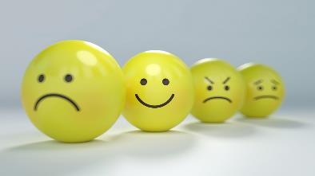

PSHE home learning:
We all have feelings
Lesson 1

Slide 2



      We are learning that we all have feelings
  We will be able to:
  recognise different feelings in ourselves and others

Slide 3

We all have feelings:
Meet Maz. Maz is an alien.
Maz is visiting earth to discover more about humans. Today Maz wants to learn all about feelings.
If you were telling Maz all about feelings, what would you say and talk about?

Slide 4

Naming and recognising feelings
We are going to look and read the words from the Feelings vocabulary cards. Choose some of words to think about.
?
?
?
?
?

Slide 5
happy | uncomfortable | excited
sad | angry | bored
calm | upset | scared
silly | worried | shy
confused | embarrassed | lonely
ashamed | confident | grumpy
comfortable | nervous

Slide 6
Naming and recognising feelings
Choose one of words to think about.
Where in his body might Maz experience this feeling?
?
?
?
?
?

Slide 7
Naming and recognising feelings
What might happen to his face when he feels it?
?
?
?
?
?

Slide 8
Naming and recognising feelings
What might happen to his whole body when he feels it?
?
?
?
?
Look in a mirror and act out the feeling as if you are showing Maz. Remember to be safe! You are only pretending!
?

Slide 9

Well Done,
you have completed lesson 1.

