Slide 1
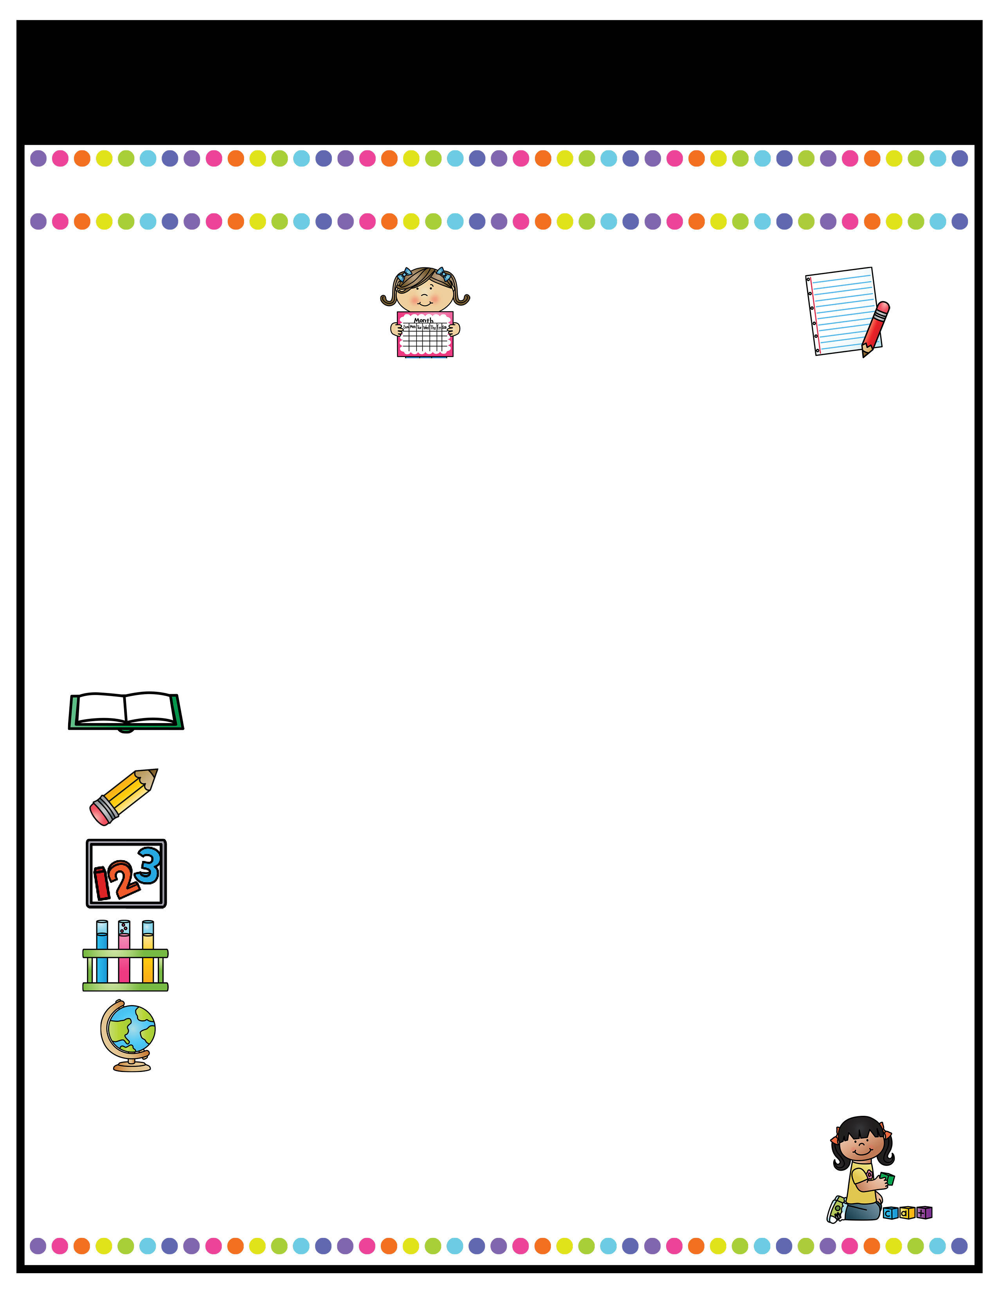
Maple Class News
Autumn Term 1
Who’s Who!
Important Things To Remember
The Maple class team for Autumn term will be Mr Holt, Miss Bzainia and Miss Elderton.
PE is on a Wednesday.
Tuck Shop is on a Friday
Your child needs to bring in a water bottle filled with water every day.
Please check Class Dojo regularly to keep up to date with the latest information and updates from the school and our class
This half term’s Values
Trust and Respect
Courage
Co-operation
Humility
Friendship
Tolerance and Kindness
A Peek At What We Are Learning
Reading | Our class novel is ‘Danny the Champion of the World’ By Roald Dahl
English | In English we will be looking at Fairy tales and writing out own modern Fairy Tales. We will also be looking at Non-Chronological reports.
Math | We are going to looking closely at numb er and place value and focusing on using a formal method for addition and subtraction. We will be having a big push on learning our times tables”
Science | In science this half term we are going to be looking at the properties of materials and how materials can change.
Geography | This half term we will be looking at Britian, locating key UK cities and towns and brushing up on our map skills.
Home Reading/ Times Tables
Your child’s Home Reading Book and times tables will be sent home every day please could your child return this daily. We understand how busy everyone is, but please could we ask that you listen to your children read even if it is just 5 minutes in an evening. It makes a massive difference!

