Slide 1
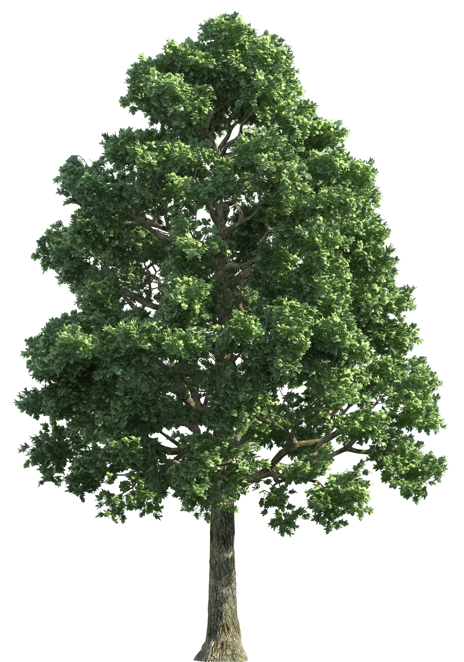
Elm’s Newsletter
Spring 1
Our team:
Welcome back everyone!
Miss Meacham and Miss Bradbury will both be teaching in Elm this half term; and the adults supporting the children will be Miss Moorhouse and Ms Edwards.
Important Reminders
PE will be on a Thursday, please can children come dressed in their PE kits (plain t-shirt, joggers, and trainers).
Children should bring a refillable water bottle.
Please check Class Dojo regularly as important updates will be posted on there, and you will receive updates on your child’s day.
In Elm, we would really like to get our children outdoors as much as possible, no matter what the weather! Please could you send in a plain spare set of clothes and shoes that you wouldn’t mind if it gets messy, as we love playing outdoors!
What we are learning:
Maths – We are going to be learning about lots of important topics, including Number and place value, Addition and subtraction, Multiplication and Division, Fractions, Statistic, and Position and Direction.
English – We are looking at a variety of topics within our Genre work, including: ‘Stories with repetitive patterns or structures’, ‘Traditional rhymes’, and writing a ‘Non-Chronological report’.
Science – We are focusing on learning about ‘Seasonal Change’, ‘Animals including Humans’, and ‘Living things and their habitats’.
Geography – Our topic is ‘The UK’. We will be finding out about the 4 countries, key mountains, rivers, capital cities and landmarks within each country.
Music – we are learning about dynamics and how to sing and play a percussion instrument demonstrating this element of music.
RE – we will learn why Christians refer to God as ‘Father’; and talk about why Christians might compare God to a loving parent/carer.
Art – we will be creating 3D images of birds, building upon our drawing skills from the Autumn term.
Social skills – We will be looking at lots of key social skills through daily activities that promote turn taking, sharing, collaboration and communication.
Values:
Week 1 – Trust and Respect
Week 2 – Hope
Week 3 – Cooperation
Week 4 – Honesty
Week 5 – Positivity (Children’s Mental health Week)
Week 6 – Tolerance and Kindness Our British Value focus for this half-term is
‘Individual Liberty’
Home Reading Folders
Home reading folders will be sent home and should be sent in daily; they will contain a reading book and a reading record. Please listen to your child read as much as possible.
Thank you, from the Elm Team.

