Slide 1

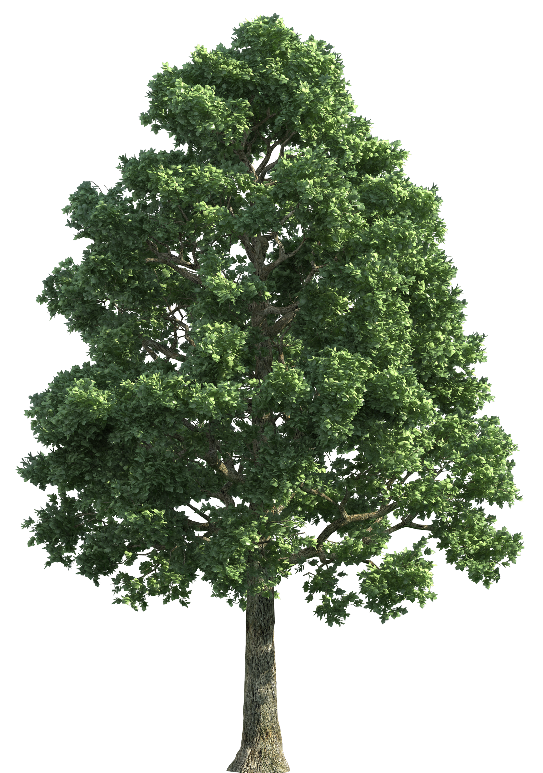





Elm’s Newsletter
Spring 2
Our team:
Welcome back everyone!
Miss Meacham and Miss Bradbury will both be teaching in Elm this half term; and the adults supporting the children will be Miss Edwards and Miss Valente.
Important Reminders
PE will be on a Thursday, please can children come dressed in their PE kits (plain t-shirt, joggers, and trainers).
Children should bring a refillable water bottle.
Please check Class Dojo regularly as important updates will be posted on there, and you will receive updates on your child’s day.
In Elm, we would really like to get our children outdoors as much as possible, no matter what the weather! Please could you send in a plain spare set of clothes and shoes that you wouldn’t mind if it gets messy, as we love playing outdoors!
What we are learning:
Maths – We are going to be learning about lots of important topics, including addition and subtraction, multiplication and division, fractions, geometry, and time.
English – We will start our half term by looking at learning some different Poems off by heart that fit around a theme.
Science – We are focusing on key Scientific Investigation Skills to enhance our understanding of our current topic, ‘Living things and their habitats’.
History – Our topic this half-term is ‘Castles’. We will be finding out how, why and where they were built; and who lived in them.
Music–we are learning about dynamics this half-term an and how to sing and play a percussion instrument demonstrating this element of music.
RE – we will be learning about Judaism with the focus question – “Why might some people put their trust in God?”
D&T – we will be learning about templates and joining techniques with textiles.
Social skills – We will continue to be look at lots of key social skills through daily activities that promote turn taking, sharing, collaboration and communication.
Values:
Week 1 – Trust and Respect
Week 2 – Patience
Week 3 – Courage
Week 4 – Understanding
Week 5 – Friendship Week 6 – Tolerance and Kindness Our British Value focus for this half-term is
‘Democracy’
Home Reading Folders
Home reading folders will be sent home and should be sent in daily; they will contain a reading book and a reading record. Please listen to your child read as much as possible.
Thank you, from the Elm Team.

