Slide 1
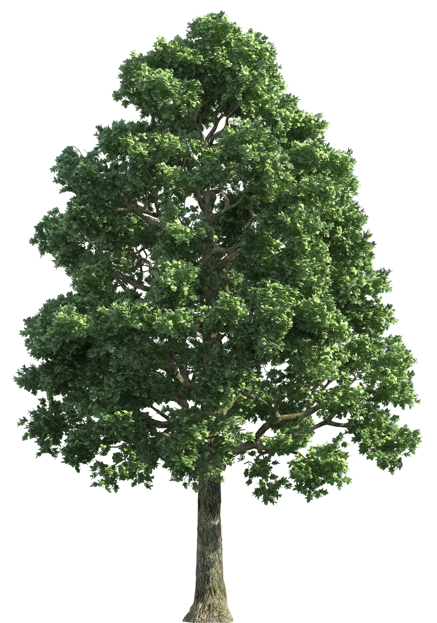
Elm’s Newsletter
Summer 1
Our team:
Welcome back everyone!
Miss Meacham and Miss Bradbury will both be teaching in Elm this half term; and the adults supporting the children will be Miss Bzainia and another as yet to be confirmed. We will let you know as soon as the person is in place..
Important Reminders
PE will be on a Thursday, please can children come dressed in their PE kits (plain t-shirt, joggers, and trainers).
Please check Class Dojo regularly as important updates will be posted on there, and you will receive updates on your child’s day.
In Elm, we really like to get our children outdoors as much as possible, no matter what the weather! Please could you send in a plain spare set of clothes and shoes that you wouldn’t mind if it gets messy, as we love playing outdoors; and also sun hats please as the weather gets warmer!
What we are learning:
Maths – We are going to be learning about lots of important topics, including ‘number and place value, addition and subtraction, multiplication and division, fractions, and money’.
English – We will start our half term by looking at learning about “instructions”, including some key features of instructions and then writing their own set of instructions.
Science – We are focusing on key Scientific Investigation Skills to enhance our understanding of our current topic, ‘Plants’.
Geography – Our topic this half-term is ‘our local environment’ and focussing on some early map skills. We will be finding out about island life in Scotland as well as
our own local area here in Lancashire.
Music–we are continuing our learning all about dynamics this half-term and how to sing and play a percussion instrument, demonstrating this element of music.
RE – we will be learning about Hinduism with the focus question – “What do Hindus believe about God?”
Art – we will be finding out all about printing, using a range of tools and techniques.
Social skills – We will continue to be look at lots of key social skills through daily activities that promote turn taking, sharing, collaboration and communication.
Values:
Week 1 – Trust and Respect
Week 2 – Caring
Week 3 – Responsibility
Week 4 – Thoughtfulness
Week 5 – Tolerance and Kindness Our British Value focus for this half-term is the
‘British Rule of Law’
Home Reading Folders
Home reading folders will be sent home and should be sent in daily; they will contain a reading book and a reading record. Please listen to your child read as much as possible.
Thank you, from the Elm Team.

